Slide 1
C++ Workshop
Provide to you by ACM created by Jimmy Yang

Slide 2

History about C++
1979: Bjarne Stroustrup starts developing "C with Classes."
1983: The first version of C++ is implemented, introducing object-oriented features and named "C++."
1985: The first edition of "The C++ Programming Language" is published by Stroustrup.
1989: The ANSI C++ standardization process begins.
1990: The first ANSI C++ standard (ANSI X3.159-1989) is published.
1998: The first international standard for C++, known as C++98, is published.
2003: A bug-fix release, C++03, is published.
2011: The release of C++11 introduces significant language and library features.
2014: C++14, a smaller update, is released.
2017: C++17 brings further enhancements and features.
2020: C++20 is released, adding more features and improvements.

Slide 3
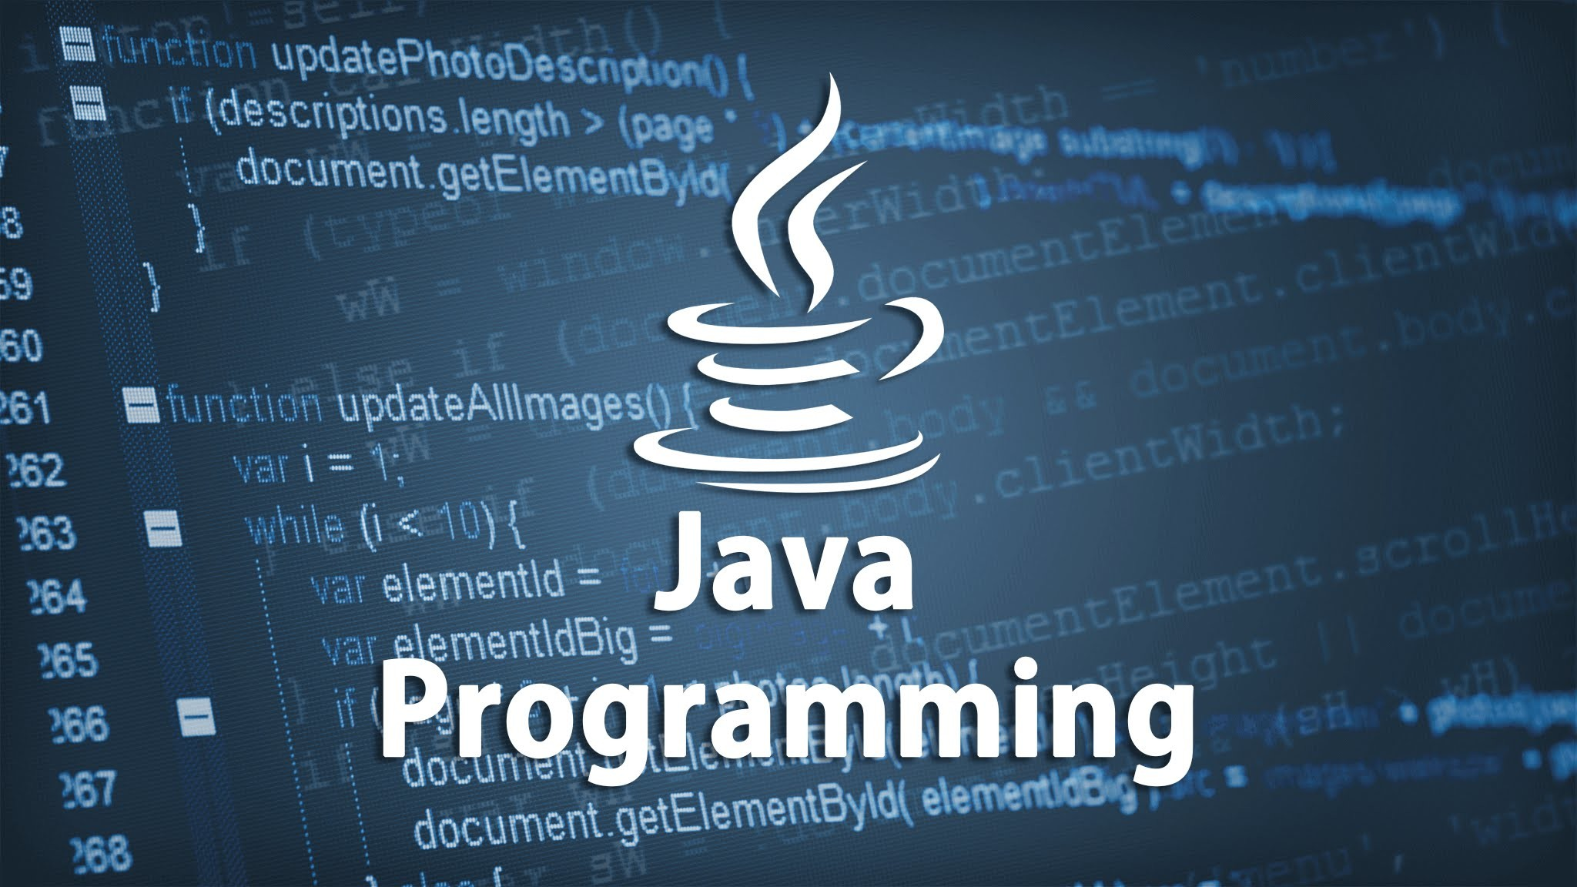
Why C++ is Cool!
Java Syntax and Elements is based off of C++ and many other programing languages like C#.

Slide 4

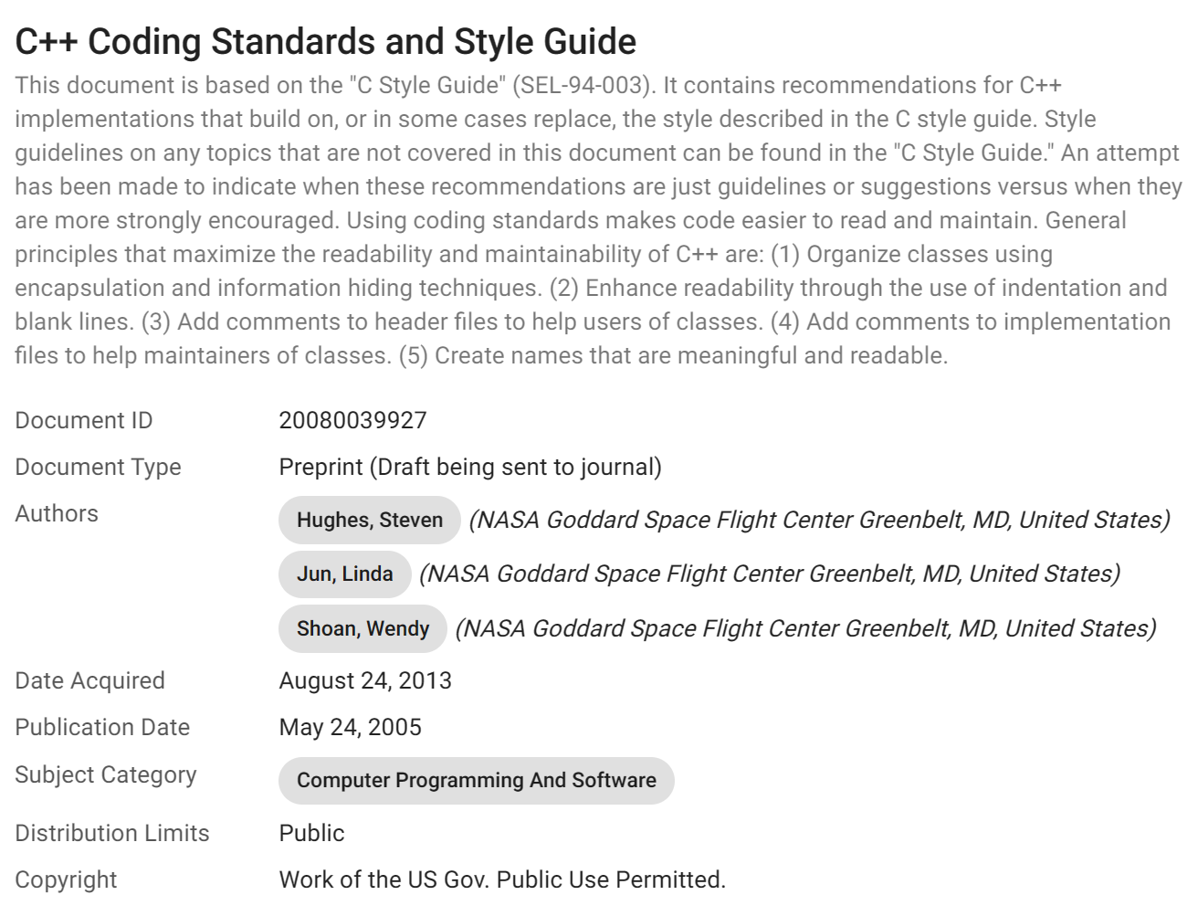
C++ in the real world
NASA - Flight Software & Embedded Systems Framework
https://ntrs.nasa.gov/citations/20080039927

Slide 5
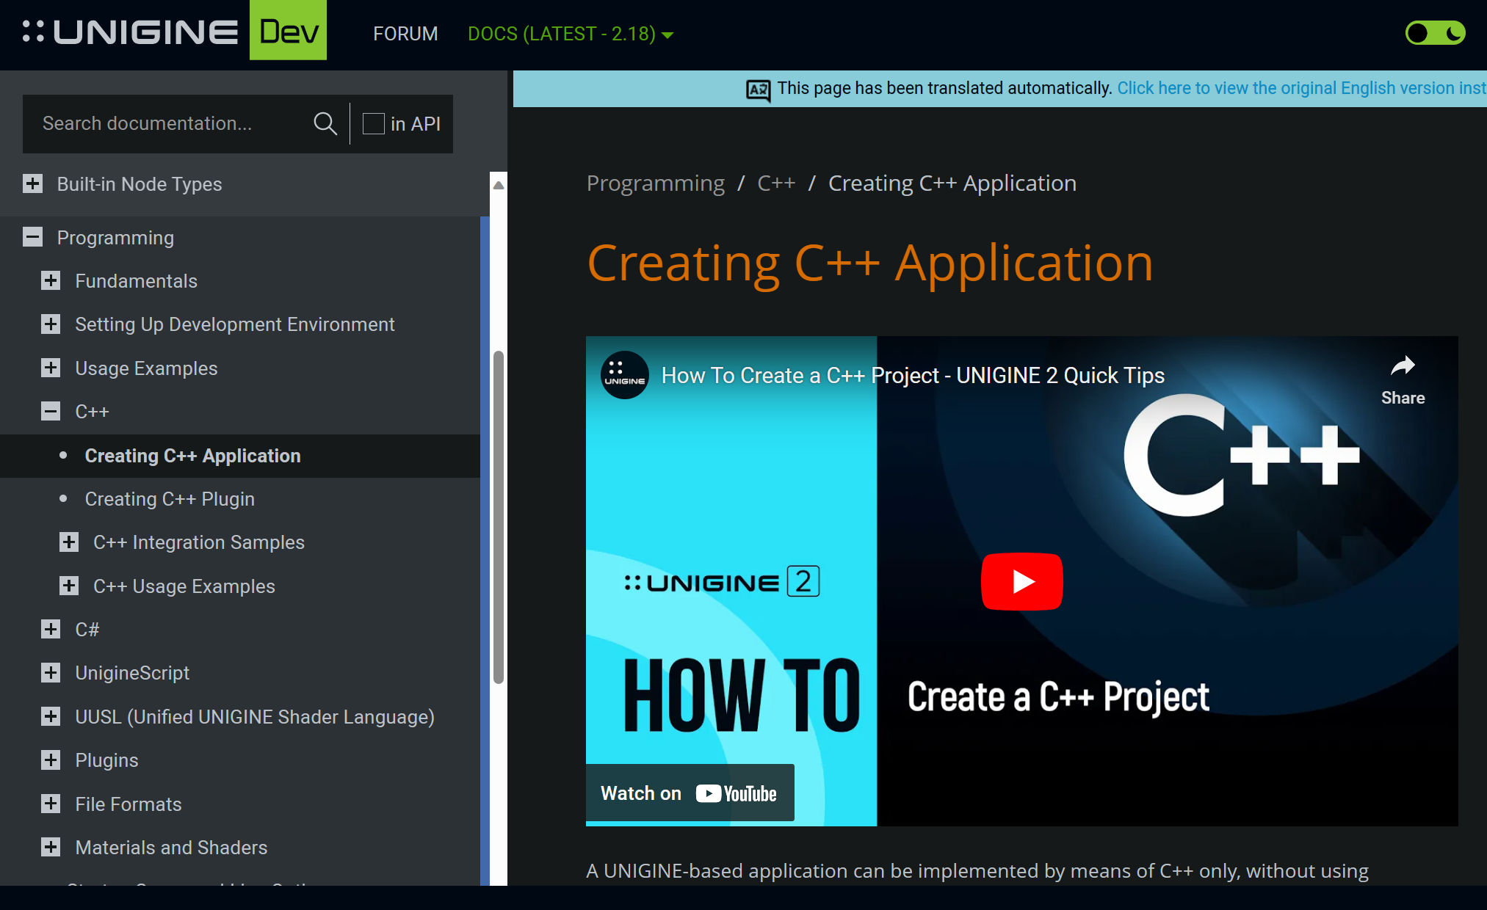
C++ and Gaming
Mortal Kombat 11
Batman Arkham Origins
Fortnite
Splinter Cell
Unreal Tournament
Half-Life 2
Portal
Killing Floor
Left 4 Dead
Team Fortress1
https://developer.unigine.com/en/docs/latest/code/cpp/application?rlang=cpp
Over 100 game engines utilize C++ !!

Slide 6
Other areas C++ is used
Operating Systems
Databases
Web Browsers
Machine Learning
AR/VR applications
Aircrafts/Automotive

Slide 7
Basics Standard Library #include (java = import) https://en.cppreference.com/w/cpp/standard_library <- for more
<iostream>: Used for input and output operations. Provides cin, cout, cerr, and other stream objects.
<iomanip>: Used for manipulating output format, such as setting the precision of floating-point numbers.
<cmath>: Provides mathematical functions like sqrt, sin, cos, etc.
<string>: Used for working with strings.
<vector>: Provides the vector container class for dynamic arrays.
<algorithm>: Includes various algorithms like sort, find, etc., which can be used with different containers.
<fstream>: Used for file input and output operations.
<sstream>: Provides functionality for string streams, allowing you to treat strings as streams.
<ctime>: Used for working with time and date functions.
<cstdio>: C-style input/output operations. Often used for functions like printf and scanf.
<cstdlib>: General utilities library. It includes functions involving memory allocation (malloc, free) and other general-purpose functions.
<cstring>: C-style string manipulation functions.
Notes:
Most commonly used STD libary

Slide 8
Basics C++ main() function
only one main function is allowed
does not have to be same name as the .cpp file extension
main function can receive command-line arguments when the program is executed (use case Google unit tests)
- int main(int argc, char* argv[])
return 0; at the end of main function meaning
- Conventionally, a return value of 0 indicates successful execution, and a non-zero value (commonly 1) indicates an error or an abnormal termination.
Notes:
Demo it and talk about it

Slide 9
Basic using namespace
Avoiding Ambiguities: Different libraries may have components with the same name. Explicitly qualifying names with the namespace helps avoid ambiguities.
Maintainability for large data structures
Notes:
Demo namespace Now get them run the first C++ program Hello World

Slide 10
Basics Variables
bool: Size: 1 byte Values: true or false
char: Size: 1 byte Values: 8-bit ASCII character (or wider character based on the encoding)
int: Size: 4 bytes (on most systems) Values: Integer numbers (e.g., -2147483648 to 2147483647 for a signed int)
float: Size: 4 bytes Values: Single-precision floating-point numbers
double: Size: 8 bytes Values: Double-precision floating-point numbers
long: Size: 4 or 8 bytes (depending on the system) Values: Extended size integer (similar to int, but with a larger range)
long long: Size: 8 bytes Values: Larger extended size integer
short: Size: 2 bytes Values: Short integer
Notes:
Demo next slide

Slide 11
Basics Variables continued
bool boolVar = true;
char charVar = 'A';
int intVar = 42;
float floatVar = 3.14f;
double doubleVar = 2.71828;
long long longLongVar = 1234567890123456LL;
short shortVar = 32767;
When you run this program, it will output the size of each variable in bytes. Note that the actual sizes can vary between different systems and compilers, but the sizes mentioned here are common on many modern systems.

Slide 12
Basics Operators
Arithmetic Operators:
+ (Addition)
- (Subtraction)
* (Multiplication)
/ (Division)
% (Modulus)
Relational Operators:
== (Equal to)
!= (Not equal to)
< (Less than)
> (Greater than)
<= (Less than or equal to)
>= (Greater than or equal to)
Logical Operators:
&& (Logical AND)
|| (Logical OR)
! (Logical NOT)
Bitwise Operators:
& (Bitwise AND)
| (Bitwise OR)
^ (Bitwise XOR)
~ (Bitwise NOT)
<< (Left shift)
>> (Right shift)

Slide 13
Basics Operators continues
Assignment Operators:
= (Assignment)
+= (Addition assignment)
-= (Subtraction assignment)
*= (Multiplication assignment)
/= (Division assignment)
%= (Modulus assignment)
&= (Bitwise AND assignment)
|= (Bitwise OR assignment)
^= (Bitwise XOR assignment)
<<= (Left shift assignment)
>>= (Right shift assignment)
Increment and Decrement Operators:
++ (Increment)
-- (Decrement)
Conditional (Ternary) Operator:
? : (Conditional operator)
Miscellaneous Operators:
sizeof (Size of an object or type)
, (Comma operator)
-> (Member access operator)
. (Member access operator)
& (Address-of operator)
* (Pointer dereference operator)
Notes:
Demo 2 fillMyBottle()

Slide 14
Basics Control Flow
Control flow refers to the order in which statements are executed in a program.
If, else if, else
Switch Statements
Loops – for, while , do-while
Control Flows –
“break” – exit loop prematurely
“continue” – skip the rest of the code in the loop move to next iteration

Slide 15
Functions
Function Declaration:
returnType functionName(parameterType1 parameterName1, parameterType2 parameterName2, ...) {
// function body
}
Function Definition:
The implementation of a function is called its definition.
Include a sample function definition.

Slide 16
Functions
Parameters and Arguments:
Functions can take parameters (input values).
Parameters are specified in the function declaration.
Arguments are the actual values passed to the function when it is called.

Slide 17
Functions
Return Values:
Functions can return a value using the return statement.
Specify the return type in the function declaration.

Slide 18
Functions
C++ supports function overloading, allowing multiple functions with the same name but different parameter lists.
int add(int a, int b) { //arguments can be changed as well
return a + b;
}
double add(double a, double b) {
return a + b;
}

Slide 19
Arrays
Declaration and Initialization:
dataType arrayName[size] = {value1, value2, ...};
Accessing Elements: (Note: there is few other ways to access using pointer methods)
Array elements are accessed using their index (starting from 0).
int numbers[5] = {10, 20, 30, 40, 50};
int thirdElement = numbers[2]; // Accessing the third element (30)

Slide 20
Arrays
Array Manipulation: (Note: pointer manipulation can also modify set elements)
Changing the value of an element.
numbers[2] = 35; // Modifying the third element
Iterating Through Arrays:
Using loops to traverse and manipulate array elements.

Slide 21
Arrays
Multidimensional Arrays:
Arrays with more than one dimension.
int matrix[3][3] = {{1, 2, 3}, {4, 5, 6}, {7, 8, 9}};
Accessing Elements in Multidimensional Arrays:
Using nested loops to access elements in a multidimensional array.
for (int i = 0; i < rows; ++i) {
for (int j = 0; j < columns; ++j) {
// code to work with matrix elements
}
}

Slide 22
Pointer *Most Important thing to understand&
Introduction to Pointers:
Pointers are variables that store memory addresses.
They allow direct manipulation of memory, providing flexibility and efficiency.
Declaring Pointers:
Syntax for declaring a pointer.
dataType *pointerName;

Slide 23
Pointer The most important SLIDE in C++
Address of Operator (&):
The “&” operator is used to get the address of a variable.
int num = 42;
int *ptr = &num; // ptr now holds the address of num
Dereference Operator (*):
int value = *ptr; // value now holds the value at the address pointed by ptr

Slide 24
Pointer
Pointer Arithmetic:
Pointers can be incremented or decremented to move through memory.
int array[5] = {1, 2, 3, 4, 5};
int *p = array; // pointer to the first element
int secondElement = *(p + 1); // accessing the second element

Slide 25
Pointer =) you be using this “new” a lot
Dynamic Memory Allocation:
“new” operator is used to allocate memory on the heap.
int *dynamicArray = new int[5];
Dynamic Memory Deallocation: (good rule to go by if you use “new” you need “delete”
“delete “operator is used to release memory allocated with new.
delete[] dynamicArray; // this is deleting previous exsample

